Slide 1

Working with Historical & Market Data

Slide 2
Topics in Working with Historical & Market Data:
  Access Market Data using libcurl in C++
Communicate between C++ and Excel

Slide 3
Access Market Data using libcurl in C++
libcurl - the multiprotocol file transfer library
  a free and easy-to-use client-side URL transfer library;
  thread-safe, IPv6 compatible, feature rich, well supported, fast, well-documented;
  highly portable, it builds and works identically on numerous platforms;
  already used by many known, big and successful companies and numerous applications.

Slide 4
Handle the Easy libcurl
libcurl first introduced the so called easy interface. All operations in the easy interface are prefixed with 'curl_easy'.
First create an easy handle:
  handle = curl_easy_init();
Set properties and options for this handle using curl_easy_setopt. They control how the subsequent transfer or transfers will be made:
  Set your preferred URL to transfer with CURLOPT_URL
  curl_easy_setopt(handle, CURLOPT_URL, "http://domain.com/");
Connect to the remote site and start transfer:
  success = curl_easy_perform(handle);
  When the transfer is complete, the function returns a return code that informs you if it succeeded in its mission or not.
If you then want to transfer another file, the handle is ready to be used again. Otherwise, clean up by calling curl_easy_cleanup(handle).

Slide 5
Configure Microsoft Visual Studio for Using LibCurl (PC users only)
Download the latest version of LibCurl from our class Web site (PC users only)
Create a new C++ project. Assume that solutions are built in Debug mode.
Go to Properties > Configuration Properties > VC++ Directories > Include directories. Add the curl directory to be found in the include directory of the unzipped Libcurl file (C:\ …\Financial Computation\libcurl\include\curl).
Go to VC++ Directories > Library directories. Add the Debug directory containing curllib_static.lib, curllib.dll and curllib.lib (C:\...\Financial Computation\libcurl\lib\Debug).
Go to Linker > General> Additional Library Directoris. Add the same Debug directory in previous step (C:\...\Financial Computation\libcurl\lib\Debug)..
Go to Linker > Input> Additional Dependencies. Here, you have to add the curllib.lib file (C:\ … \lib\Debug\curllib.lib). Type in the name of the lib file.
Copy over curllib.dll, libeay32.dll, openldap.dll, libsasl.dll and ssleay32.dll in the Debug directory of your project. There all are to be found in the root directory of Libcurl.

Slide 6
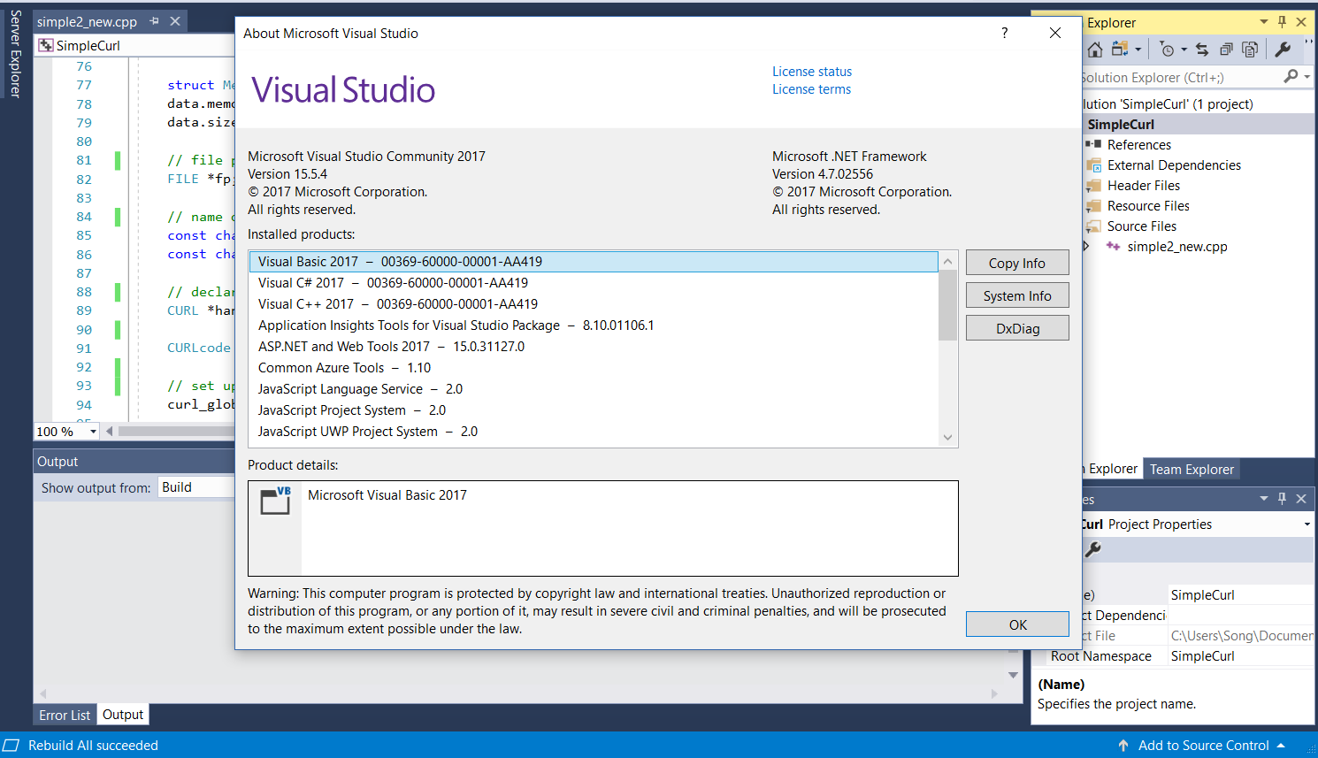

Slide 7
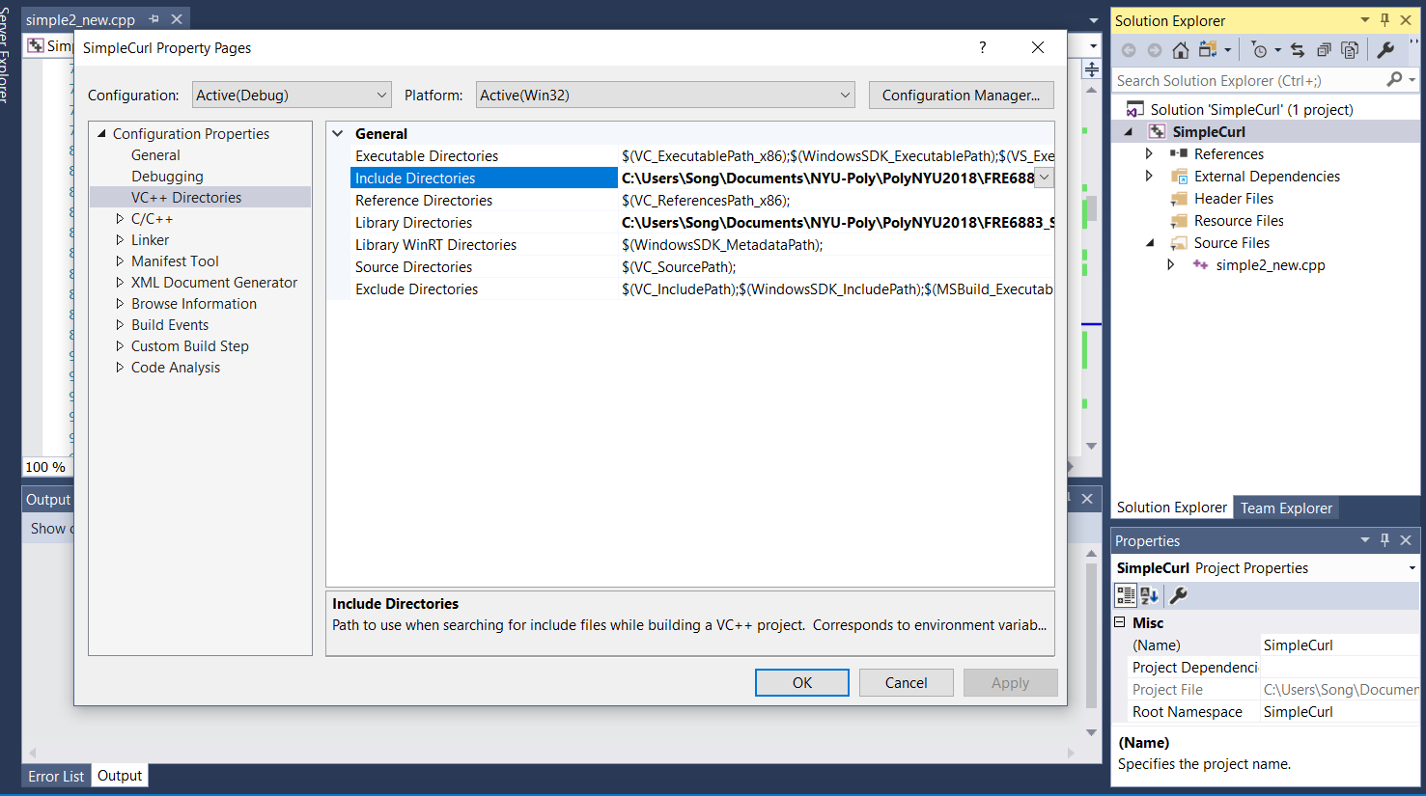

Slide 8
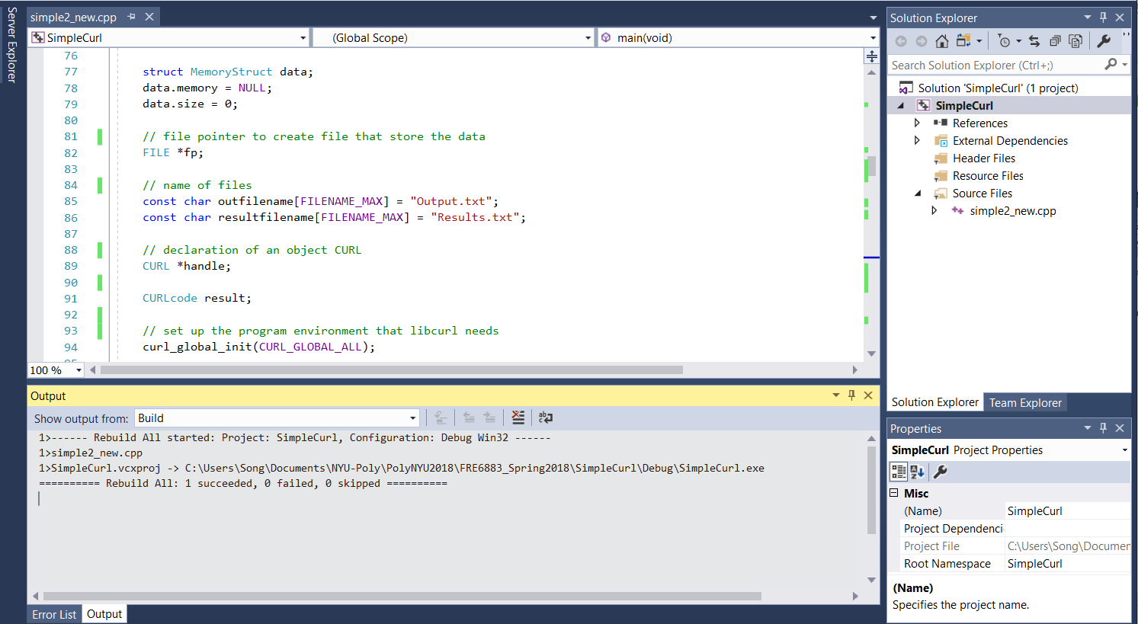

Slide 9
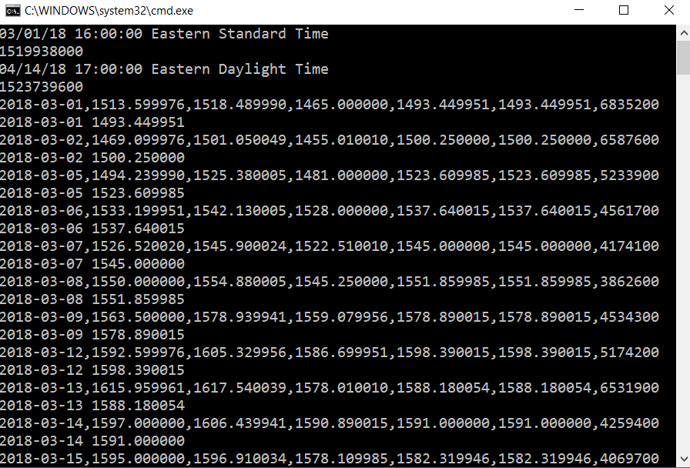

Slide 10
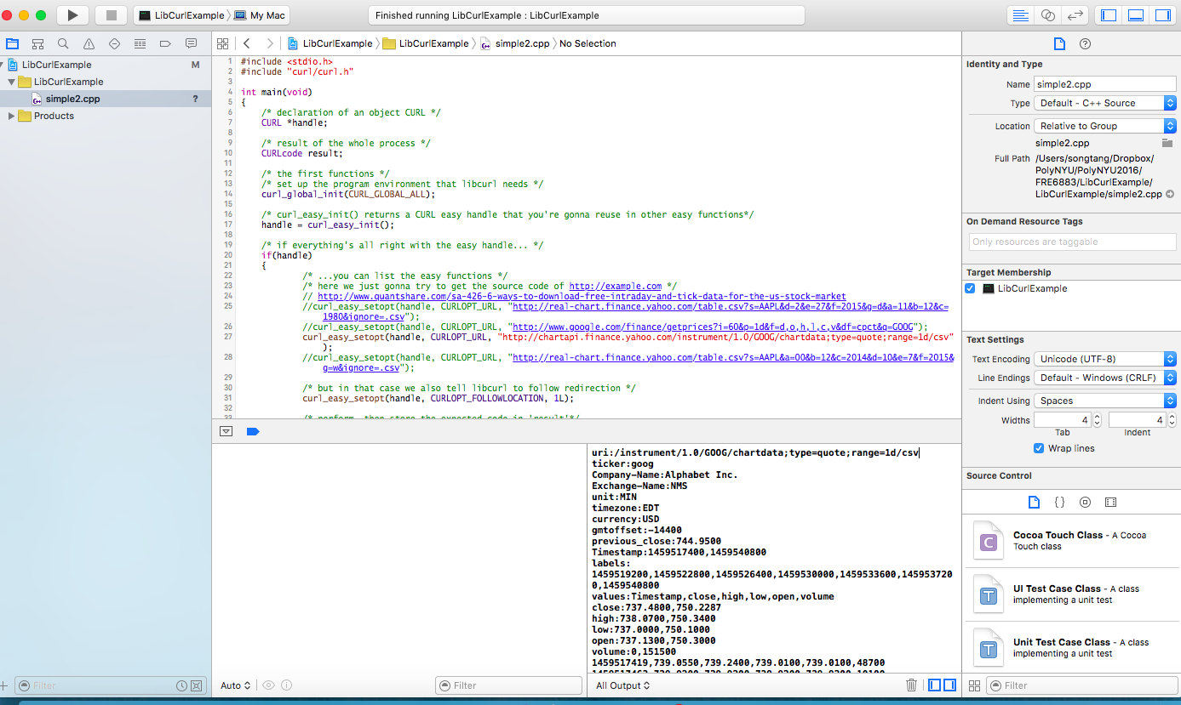

Slide 11
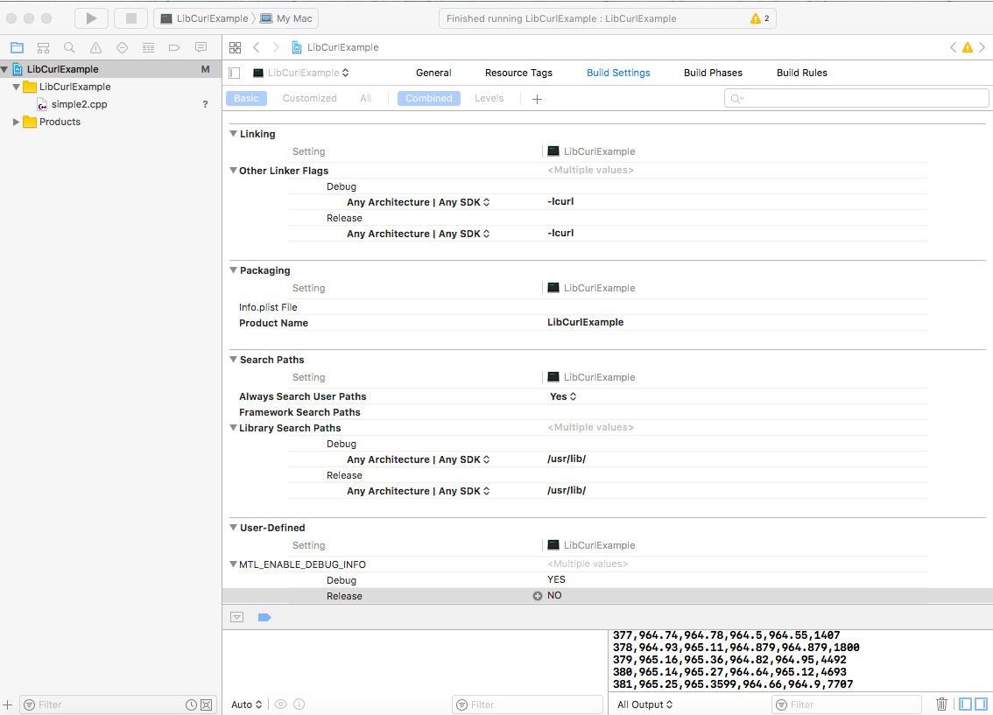

Slide 12
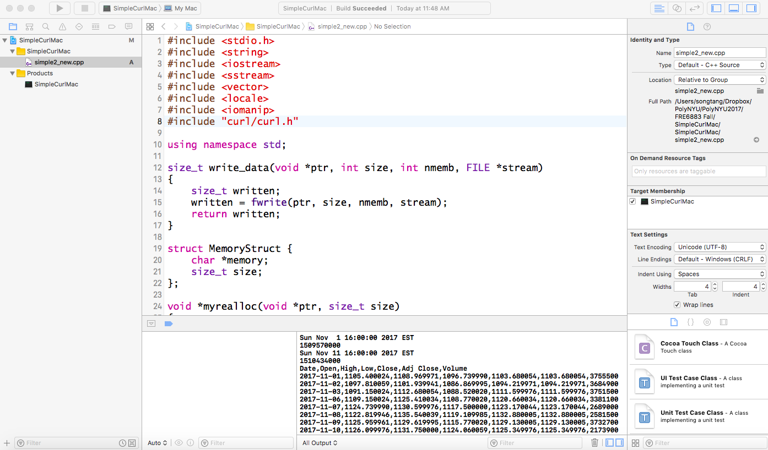

Slide 13
Transfer a Web page from Yahoo Finance
We create a simple C++ program to use libcurl to transfer the daily historical prices (9/1/2018 – 10/31/2018) of a list of stocks (AMZN, MSFT and TWTR) from Yahoo Finance to a file, Results.txt.
You will enhance the program to retrieve market data for your group project.

Slide 14
#include <stdio.h>
#include <string>
#include <iostream>
#include <sstream>
#include <vector>
#include <locale>
#include <iomanip>
#include "curl.h"
using namespace std;
//yahoo finance connection
int write_data(void *ptr, int size, int nmemb, FILE *stream)
{
size_t written;//size*nmems
written = fwrite(ptr, size, nmemb, stream); //system call
return written;
}

Slide 15
struct MemoryStruct {
char *memory;
size_t size;
};
void *myrealloc(void *ptr, size_t size)
{
/* There might be a realloc() out there that doesn't like reallocting NULL pointers, so we take care of it here */
if (ptr)
return realloc(ptr, size);
else
return malloc(size);
}

Slide 16
int write_data2(void *ptr, size_t size, size_t nmemb, void *data)
{
size_t realsize = size * nmemb;
struct MemoryStruct *mem = (struct MemoryStruct *)data;
mem->memory = (char *)myrealloc(mem->memory, mem->size + realsize + 1);
if (mem->memory) {
memcpy(&(mem->memory[mem->size]), ptr, realsize);
mem->size += realsize;
mem->memory[mem->size] = 0;
}
return realsize;
}

Slide 17

string getTimeinSeconds(string Time)
{
std::tm t = {0};
std::istringstream ssTime(Time);
char time[100];
memset(time, 0, 100);
if (ssTime >> std::get_time(&t, "%Y-%m-%dT%H:%M:%S"))
{
cout << std::put_time(&t, "%c %Z") << "\n"
<< std::mktime(&t) << "\n";
sprintf (time, "%lld", mktime(&t));
return string(time);
}
else
{
cout << "Parse failed\n";
return "";
}
}

Slide 18
int main(void)
{
string startTime = getTimeinSeconds("2018-09-01T16:00:00");
string endTime = getTimeinSeconds("2018-11-16T16:00:00");
vector<string> symbolList;
symbolList.push_back(string("AMZN"));
symbolList.push_back(string("MSFT"));
symbolList.push_back(string("TWTR"));
vector<string>::iterator itr = symbolList.begin();
struct MemoryStruct data;
data.memory = NULL;
data.size = 0;
//file pointer to create file that store the data
FILE *fp;
//name of files
const char outfilename[FILENAME_MAX] = "Output.txt";
const char resultfilename[FILENAME_MAX] = "Results.txt";

Slide 19
// declaration of an object CURL
CURL *handle;
// result of the whole process
CURLcode result;
// set up the program environment that libcurl needs
curl_global_init(CURL_GLOBAL_ALL);
// curl_easy_init() returns a CURL easy handle
handle = curl_easy_init();

Slide 20
if (handle)
{
while (true)
{ string sCookies, sCrumb;
if (sCookies.length() == 0 || sCrumb.length() == 0)
{ fp = fopen(outfilename, "w");
curl_easy_setopt(handle, CURLOPT_URL,
"https://finance.yahoo.com/quote/AMZN/history");
curl_easy_setopt(handle, CURLOPT_SSL_VERIFYPEER, 0);
curl_easy_setopt(handle, CURLOPT_SSL_VERIFYHOST, 0);
curl_easy_setopt(handle, CURLOPT_COOKIEJAR, "cookies.txt");
curl_easy_setopt(handle, CURLOPT_COOKIEFILE, "cookies.txt");
curl_easy_setopt(handle, CURLOPT_ENCODING, "");
curl_easy_setopt(handle, CURLOPT_WRITEFUNCTION, write_data);
curl_easy_setopt(handle, CURLOPT_WRITEDATA, fp);
result = curl_easy_perform(handle);
fclose(fp);
if (result != CURLE_OK)
{ /* if errors have occurred, tell us what is wrong with 'result'*/
fprintf(stderr, "curl_easy_perform() failed: %s\n", curl_easy_strerror(result));
return 1;
}

Slide 21
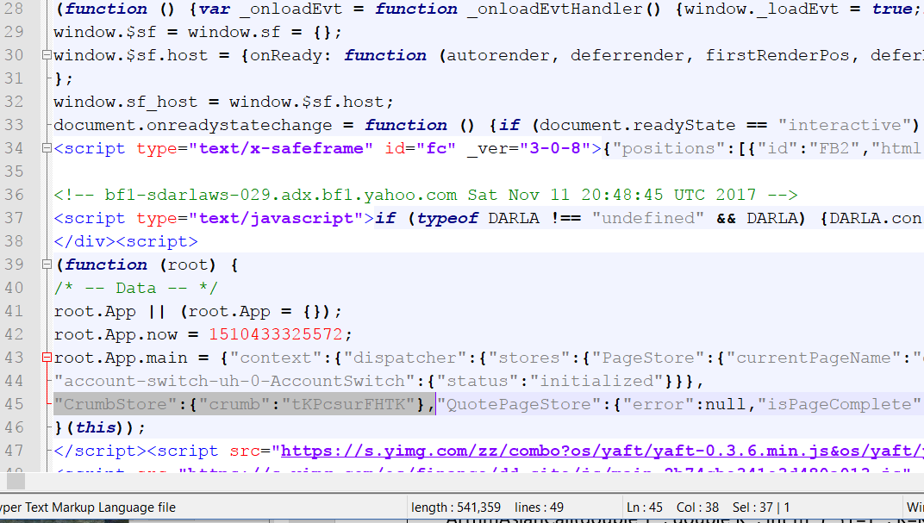
Output.txt

Slide 22
curl_easy_setopt(handle, CURLOPT_WRITEFUNCTION, write_data2);
curl_easy_setopt(handle, CURLOPT_WRITEDATA, (void *)&data);
// perform, then store the expected code in result
result = curl_easy_perform(handle);
if (result != CURLE_OK)
{
// if errors have occurred, tell us what is wrong with result
fprintf(stderr, "curl_easy_perform() failed: %s\n", curl_easy_strerror(result));
return 1;
}

Slide 23
char cKey[] = "CrumbStore\":{\"crumb\":\"";
char *ptr1 = strstr(data.memory, cKey);
char *ptr2 = ptr1 + strlen(cKey);
char *ptr3 = strstr(ptr2, "\"}");
if ( ptr3 != NULL )
*ptr3 = NULL;
sCrumb = ptr2;
fp = fopen("cookies.txt", "r");
char cCookies[100];
if (fp) {
while (fscanf(fp, "%s", cCookies) != EOF);
fclose(fp);
}
else
cerr << "cookies.txt does not exists" << endl;
sCookies = cCookies;
free(data.memory);
data.memory = NULL;
data.size= 0;
}

Slide 24
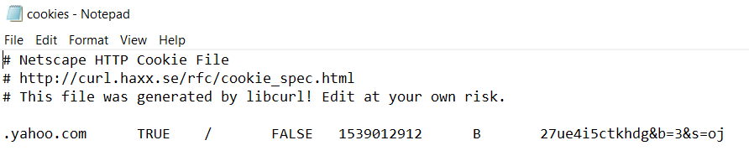

Slide 25
if (itr == symbolList.end())
break;
string urlA = "https://query1.finance.yahoo.com/v7/finance/download/";
string symbol = *itr;
string urlB = "?period1=";
string urlC = "&period2=";
string urlD = "&interval=1d&events=history&crumb=";
string url = urlA + symbol + urlB + startTime + urlC + endTime + urlD + sCrumb;
const char * cURL = url.c_str();
const char * cookies = sCookies.c_str();
curl_easy_setopt(handle, CURLOPT_COOKIE, cookies);
curl_easy_setopt(handle, CURLOPT_URL, cURL);
fp = fopen(resultfilename, "ab");
curl_easy_setopt(handle, CURLOPT_WRITEFUNCTION, write_data);
curl_easy_setopt(handle, CURLOPT_WRITEDATA, fp);
result = curl_easy_perform(handle);
fclose(fp);
/* Check for errors */
if (result != CURLE_OK)
{ fprintf(stderr, "curl_easy_perform() failed: %s\n", curl_easy_strerror(result));
return 1;
}

Slide 26
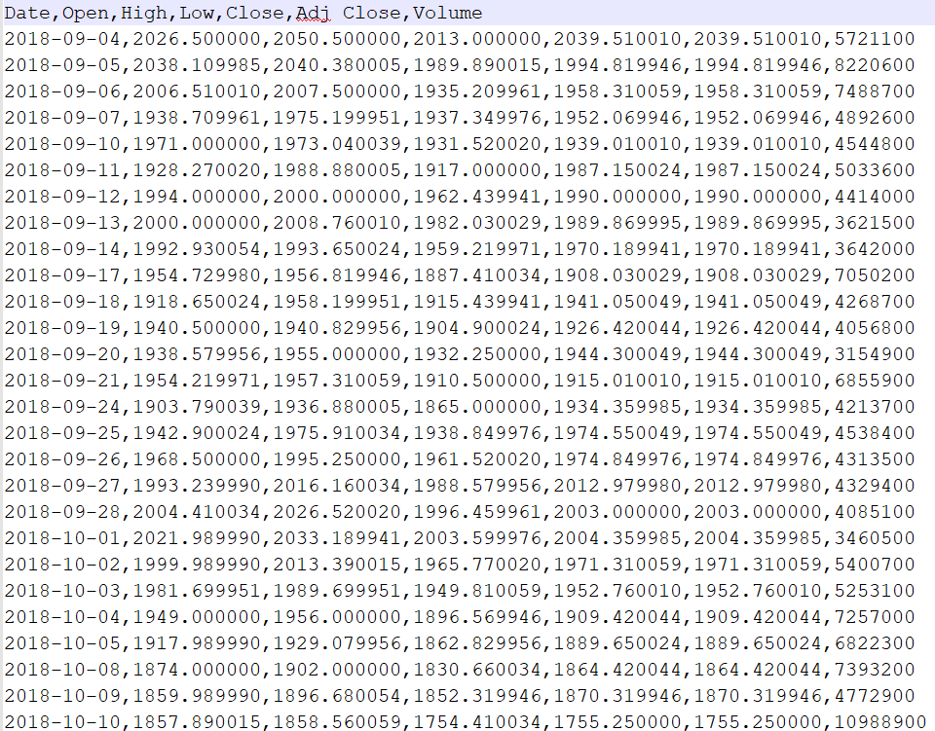
Results.txt

Slide 27
curl_easy_setopt(handle, CURLOPT_WRITEFUNCTION, write_data2);
curl_easy_setopt(handle, CURLOPT_WRITEDATA, (void *)&data);
result = curl_easy_perform(handle);
/* Check for errors */
if (result != CURLE_OK)
{ /* if errors have occured, tell us wath's wrong with 'result’*/
fprintf(stderr, "curl_easy_perform() failed: %s\n", curl_easy_strerror(result));
return 1;
}
stringstream sData;
sData.str(data.memory);
string line;
getline(sData, line);
cout << line << endl;
for (; getline(sData, line); )
cout << line << endl;
itr++;
}
free(data.memory);
data.size= 0;
}

Slide 28
else
{ fprintf(stderr, "Curl init failed!\n");
return 1;
}
/* cleanup since you've used curl_easy_init */
curl_easy_cleanup(handle);
/* this function releases resources acquired by curl_global_init() */
curl_global_cleanup();
return 0;
}

Slide 29
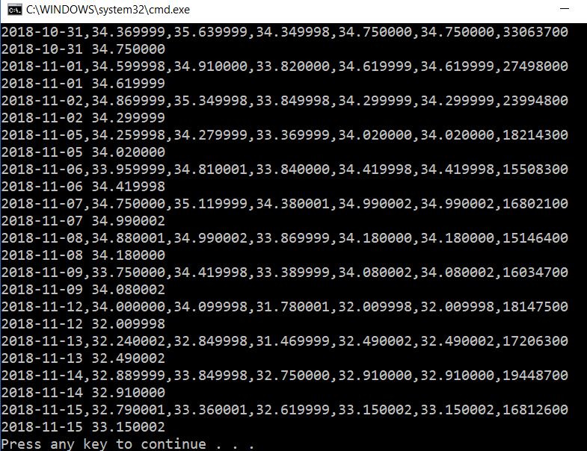

Slide 30
Communicate between C++ and Excel
Exporting cell data to Excel from C++ to Excel for further processing.
Display results from different branches of C++ Numerical Analysis Engine as Excel graphs.
Using Excel as a simple database.

Slide 31
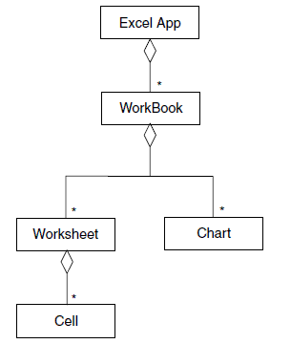
Object Model in Excel
A cell is an atomic entity in Excel and is a placeholder for data. We address a cell giving its row and column position in a worksheet. In general, a worksheet consists of cells.
A range is a collection of cells. A range can be a one-dimensional array or a two-dimensional array.
An Excel application may contain several workbooks. A workbook
consists of a number of worksheets and charts.

Slide 32
Technical Details of C++ Interfacing to Excel
The ‘life cycle’ of the Excel application by a number of activities:
  Initialize COM (otherwise we cannot start Excel);
  Create an instance of the Excel application;
  Optional: you can make Excel visible or invisible at start up time;
  Make a workbook the (current) active workbook;
  Access a given worksheet in a workbook;
  Rename a worksheet.

Slide 33
In the ExcelDriver class these steps are executed in its default constructor:
  try
  {
  // Initialise COM Runtime Libraries.
  CoInitialise(NULL);
  // Start Excel application.
  xl.CreateInstance(L"Excel.Application");
  xl->Workbooks->Add(Excel::xlWorksheet);
  // Rename "Sheet1" to "Chart Data".
  Excel::_WorkbookPtr pWorkbook = xl->ActiveWorkbook;
  Excel::_WorksheetPtr pSheet=pWorkbook->Worksheets->GetItem("Sheet1");
  pSheet->Name = "Chart Data";
  }
  catch( _com_error & error )
  {
  ThrowAsString(error);
  }

Slide 34
Two Main Function Entities of Excel Driver Package:
ExcelDriver: a C++ class that is an adapter or wrapper for the COM interface to Excel. The driver class encapsulates some low-level functionality on C++ to Excel interoperability and clients access the class only through its public interface.
ExcelMechanisms: a suite of generic functions that display one, two- and three-dimensional data in a variety of formats. It creates a number of procedures that display vectors, matrices and tensors as line graphs or in cell and range formats.

Slide 35
The header file of ExcelDriver class
class ExcelDriver
{
private:
static ExcelDriver * singleton; // Excel Driver is a Singleton
Excel::_ApplicationPtr xl; // Pointer to Excel.
long curDataColumn; // Current column of 'Chart Data'
// Writes label and vector to cells in horizontal direction.
void ToSheetHorizontal( Excel::_WorksheetPtr sheet, long sheetRow,
long sheetColumn,const std::string& label,const Vector<double, long> & values );
// Writes label and vector to cells in vertical direction.
void ToSheetVertical( Excel::_WorksheetPtr sheet, long sheetRow, long sheetColumn,
const std::string& label, const Vector<double, long> & values );
void ThrowAsString( _com_error & error ); // Throw COM error as string.

Slide 36
public:
ExcelDriver(); // Constructor. Starts Excel in invisible mode.
virtual ~ExcelDriver(); // Destructor.
// Access to single, shared instance of ExcelDriver (singleton).
static ExcelDriver& Instance();
// Create chart with a number of functions. The arguments are:
// x:vector with input values
// labels:labels for output values
// vectorList: list of vectors with output values.
// chartTitle:title of chart
// xTitle:label of x axis
// yTitle:label of y axis
void CreateChart(const Vector<double, long> & x, const list<string> & labels,
const list<Vector<double, long> > & vectorList, const std::string& chartTitle,
const std::string& xTitle = "X", const std::string& yTitle = "Y");

Slide 37
// Create chart with a number of functions. The arguments are:
// x:vector with input values
// y:vector with output values.
// chartTitle:title of chart
// xTitle:label of x axis
// yTitle:label of y axis
void CreateChart(const Vector<double, long> & x, const Vector<double, long> & y,
const std::string& chartTitle, const std::string& xTitle = "X", const std::string& yTitle = "Y");
// Add Matrix to the spreadsheet with row and column labels.
void AddMatrix(const std::string& sheetName, const NumericMatrix<double, long>& matrix,
const list<std::string>& rowLabels, const list<std::string>& columnLabels);
void AddMatrix(const NumericMatrix<double, long>& matrix,
const std::string& SheetName = "Matrix" );
void MakeVisible( bool b);
};

Slide 38
Singleton Design Pattern used by ExcelDriver
The Singleton Design pattern is used, where only one instance of a class is needed throughout the lifetime of an application. The Singleton class is instantiated at the time of first access and same instance is used thereafter till the end of the application.
ExcelDriver * ExcelDriver::singleton = NULL;
ExcelDriver& ExcelDriver::Instance()
  { if (!singleton)
  singleton = new ExcelDriver;
  return *singleton;
  }

Slide 39
Testing Excel Driver:
int main()
{ long N = 20; long M = 30;
NumericMatrix<double, long> matrix(N+1, M+1);
// Create the x and y arrays
Vector<double, long> xarr(N+1);
Vector<double, long> yarr(N+1);
Vector<double, long> yarr2(N+1);
double h1 = 0.1, h2 = 0.2;
xarr[xarr.MinIndex()] = 0.0;
for (long i = xarr.MinIndex()+1; i <= xarr.MaxIndex(); i++)
{ xarr[i] = xarr[i-1] + h1;
}
yarr[yarr.MinIndex()] = 0.0;
for (long j = yarr.MinIndex()+1; j <= yarr.MaxIndex(); j++)
{ yarr[j] = yarr[j-1] + h2;
yarr2[j] = yarr2[j-1] + yarr[j];
}

Slide 40
// Create textual information
list<std::string> rowlabels = convertToString(xarr);
list<std::string> columnlabels = convertToString(yarr);
std::string sheetName("First");
// Start Excel and make it visible
ExcelDriver& excel = ExcelDriver::Instance();
excel.MakeVisible(true); // Default is INVISIBLE!
// Send the matrix to Excel
excel.AddMatrix(sheetName, matrix, rowlabels, columnlabels);
try
{ printDifferenceInExcel(xarr, yarr2, yarr); // Difference of vectors
}
catch(DatasimException& e)
{ e.print();
}
catch (...)
{ // Catches everything else
}
return 0;
}

Slide 41
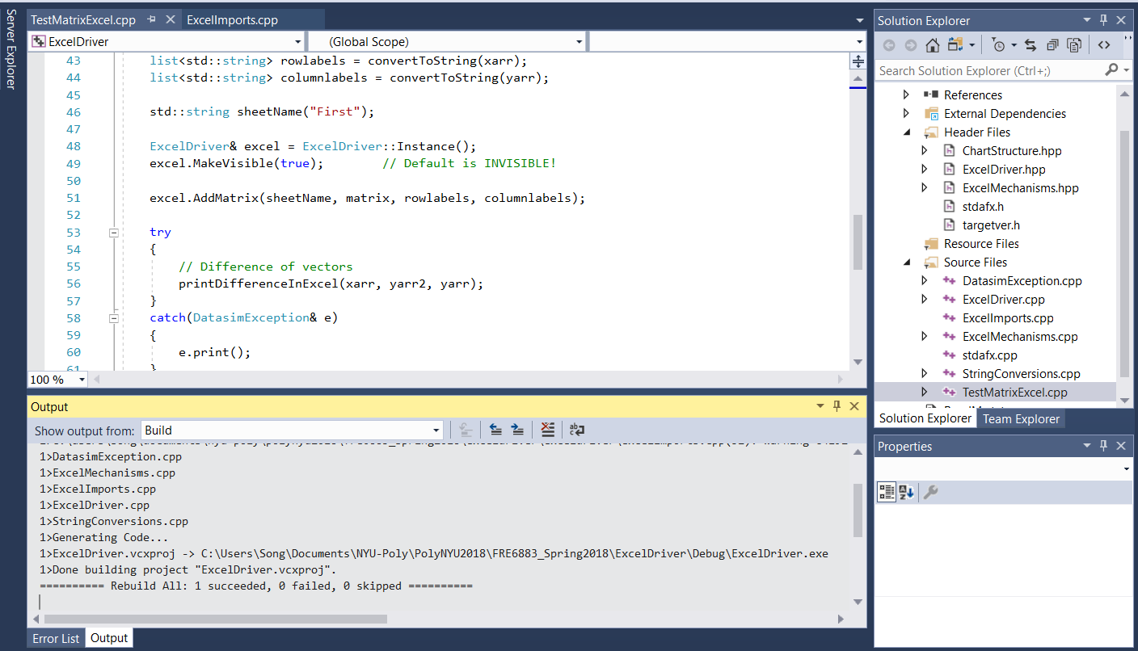

Slide 42
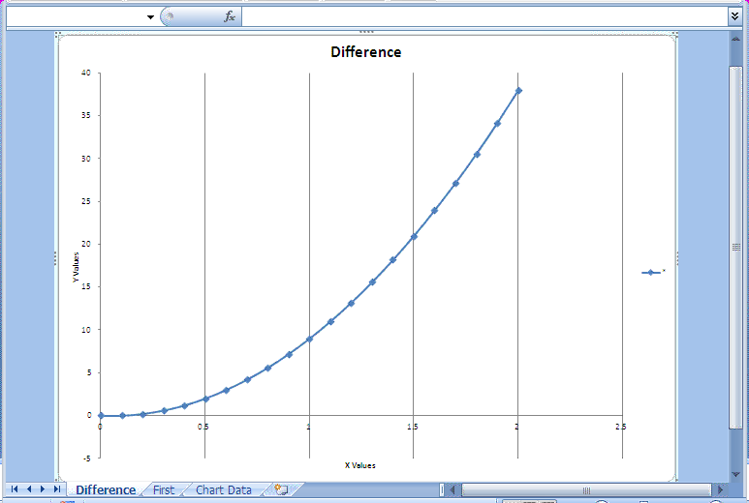

Slide 43
The header file of ExcelMechanisms (partially):
// Print one line graph
void printOneExcel(const Vector<double, long>& x, const Vector<double, long>& functionResult,
const std::string& title = string("Title"), const std::string& horizontal = string("X"),
const std::string& vertical = string("Y"), const std::string& legend = string("*"));
// Print multiple lines on one graph
void printInExcel(const Vector<double, long>& x, // X array
const list<std::string>& labels, // Names of each vector
const list<Vector<double, long> >& functionResult, // The list of Y values, need to convert
const std::string& title = string("Title"),
const std::string& horizontal = string("X"),
const std::string& vertical = string("Y"));
// Print a matrix as cell
void printMatrixInExcel(const NumericMatrix<double, long>& matrix,
const Vector<double, long>& xarr, const Vector<double, long>& yarr,
const std::string& SheetName = string("Matrix"));

Slide 44
// Print each matrix in tensor with associated row/column labels
void printTensorInExcel(const Tensor<double, long>& tensor,
const Vector<double, long>& xarr, const Vector<double, long>& yarr,
const std::string& SheetName = string("Tensor"), long freq = 1);
// Print the vector that is the difference of two vectors
void printDifferenceInExcel(const Vector<double, long>& x,const Vector<double, long>& y1,
const Vector<double, long>& y2,
const std::string& title = string("Difference"),
const std::string& horizontal = string("X Values"),
const std::string& vertical = string("Y Values"),
const std::string& legend = string("*"),
long freq = 1);
// Print discrete values of a continuous function on interval [A,B]
void printDiscreteFunctionValues(double (*f) (double x), double A, double B, long nSteps,
const std::string& title,
const std::string& horizontal, const std::string& vertical,
const std::string& legend);

Slide 45
These functions display n-dimensional data (n=1, 2 and 3) in a variety of formats.
It is also possible to define so-called context information such as:
  The title of the sheet (sheet names must be unique.)
  The title of the chart.
  The title of the legend.
  The title of the horizontal and vertical axes.

Slide 46
Option Values and Sensitivities in Excel
Create a class, ExtendedOption, that calculates option pricing functionality and its sensitivities.
Create a class, ExtendedOptionPresentation to use ExcelDriver package to display the price of call and put options as well as their sensitivities in Excel worksheets and charts.

Slide 47
ExtendedOption:
What is the relationship between ExtendedOption and Option?
class ExtendedOption : public Option
{
private: // Private member data and functions
……
public: // Public property section
// option parameters public purely for convenience
double r; // Interest rate
double sig; // Volatility
double K; // Strike price
double T; // Expiry date
double U; // Current underlying price
double b; // Cost of carry
string otyp; // Option name (call, put)
public: // Public functions
ExtendedOption();
ExtendedOption(const ExtendedOption& option2);

Slide 48
ExtendedOption (const string& optionType);
ExtendedOption (const string& optionType, const string& underlying);
virtual ∼ExtendedOption();
ExtendedOption& operator = (const ExtendedOption& option2);
// Functions that calculate option price and sensitivities
double Price(double U) const;
double Delta(double U) const;
double Gamma(double U) const;
double Vega(double U) const;
double Theta(double U) const;
double Rho(double U) const;
double Coc(double U) const;
double Elasticity(double percentageMovement, double U ) const;
// Modifier functions
void toggle(); // Change option type (C/P, P/C)
};

Slide 49
ExtendedOptionPresentation:
enum OptionValueType {Value, Delta, Gamma, Vega, Theta, Rho, Coc, Elasticity};
class ExtendedOptionPresentation
{
private:
ExtendedOption* curr;
Range<double> r; // Extent of x axis
long nSteps; // Number of subdivisions
Vector<double, long> XARR;
ExtendedOptionPresentation() {}
public:
ExtendedOptionPresentation(ExtendedOption& option, const Range<double>& extent,
long NumberSteps)
{ r = extent;
nSteps = NumberSteps;
curr = &option;
XARR = r.mesh(nSteps);
}

Slide 50
Vector<double, long> calculate(OptionValueType yval)
{ // Contains value at end-points
Vector<double, long> result (nSteps+1, 1);
if (yval == Value)
{ for (int j = XARR.MinIndex(); j <= XARR.MaxIndex(); j++)
result[j] = curr -> Price(XARR[j]);
}
else if (yval == Delta)
{ for (int j = XARR.MinIndex(); j <= XARR.MaxIndex(); j++)
result[j] = curr -> Delta(XARR[j]);
}
else if (yval == Gamma)
{ for (int j = XARR.MinIndex(); j <= XARR.MaxIndex(); j++)
result[j] = curr -> Gamma(XARR[j]);
}
else if (yval == Vega)
{ for (int j = XARR.MinIndex(); j <= XARR.MaxIndex(); j++)
result[j] = curr -> Vega(XARR[j]);
}

Slide 51
else if (yval == Theta)
{ for (int j = XARR.MinIndex(); j <= XARR.MaxIndex(); j++)
result[j] = curr -> Theta(XARR[j]);
}
else if (yval == Rho)
{ for (int j = XARR.MinIndex(); j <= XARR.MaxIndex(); j++)
result[j] = curr -> Rho(XARR[j]);
}
else if (yval == Coc)
{ for (int j = XARR.MinIndex(); j <= XARR.MaxIndex(); j++)
result[j] = curr -> Coc(XARR[j]);
}
return result;
}

Slide 52
  void displayinExcel( OptionValueType yval)
  { string text("Value");
  if (yval == Delta)
  text = string("Delta");
  else if (yval == Gamma)
  text = string("Gamma");
  else if (yval == Vega)
  text = string("Vega");
  else if (yval == Theta)
  text = string("Theta");
  else if (yval == Rho)
  text = string("Rho");
  else if (yval == Coc)
  text = string("Coc");
  Vector<double, long> yarr = calculate(yval);
  printOneExcel(XARR, yarr, text);
  }
};

Slide 53
TestExtendedOption.cpp
#include "ExtendedOptionPresentation.hpp"
#include <iostream>
int main()
{ // European Put option on a stock index
ExtendedOption indexOption;
indexOption.otyp = "P";
indexOption.K = 95.0;
indexOption.T = 0.5;
indexOption.r = 0.06;
indexOption.sig = 0.20;
double q = 0.0; // Dividend yield
indexOption.b = indexOption.r - q;
cout << "Put option on an index: " << indexOption.Price(100.0) << endl;
// Sub-division of "underlying" interval
Range<double> extent (0.01, 210.01);
long NumberSteps = 210;

Slide 54
  ExtendedOptionPresentation myPresent(indexOption, extent, NumberSteps);
  OptionValueType val = Value;
  myPresent.displayinExcel(val);
  val = Delta;
  myPresent.displayinExcel(val);
  val = Gamma;
  myPresent.displayinExcel(val);
  val = Vega;
  myPresent.displayinExcel(val);
  val = Theta;
  myPresent.displayinExcel(val);
  val = Rho;
  myPresent.displayinExcel(val);
  val = Coc;
  myPresent.displayinExcel(val);
  return 0;
  }

Slide 55
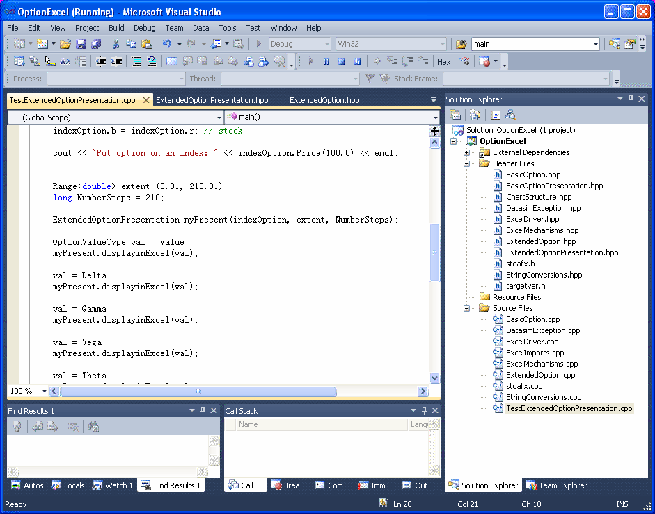

Slide 56
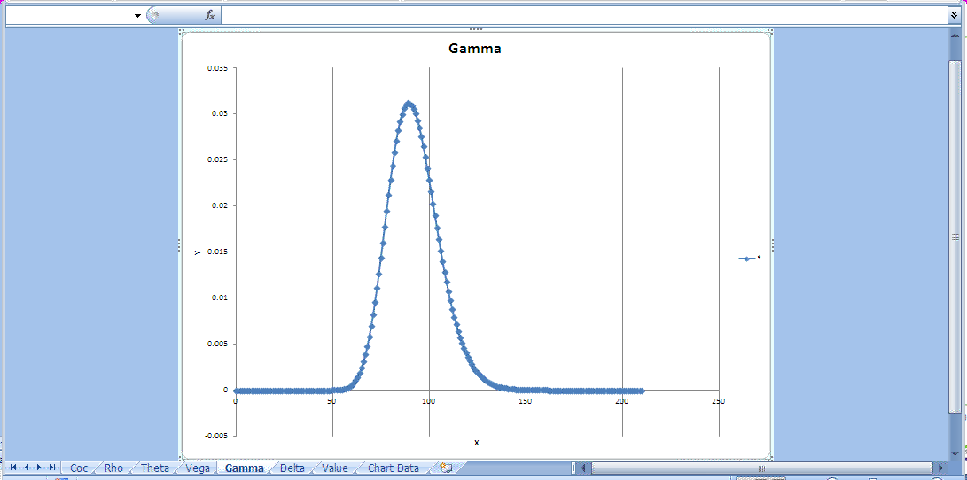

Slide 57
Gnuplot
Gnuplot is a portable command-line driven interactive data and function plotting utility for UNIX, IBM OS/2, MS Windows, DOS, Macintosh, VMS, Atari and many other platforms. It was originally intended as to allow scientists and students to visualize mathematical functions and data. It does this job pretty well, but has grown to support many non-interactive uses, including web scripting and integration as a plotting engine for third-party applications like Octave. Gnuplot supports many types of plots in either 2D and 3D. It can draw using lines, points, boxes, contours, vector fields, surfaces, and various associated text.

Slide 58
Calling gnuplot from C/C++ on Mac OS X http://pleasemakeanote.blogspot.com/2012/09/calling-gnuplot-from-cc-on-mac-os-x.html
Install macports from: http://www.macports.org/
Reboot your computer.
Open up your terminal
type: sudo port selfupdate (to update port names)
type: sudo port install gnuplot

Slide 59
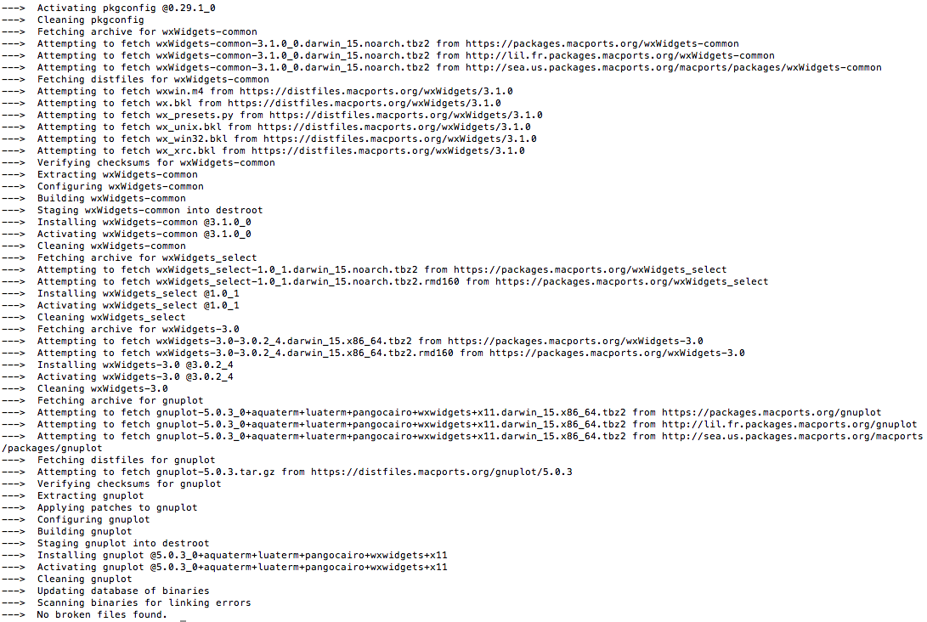
Completion of gnuplot installation

Slide 60
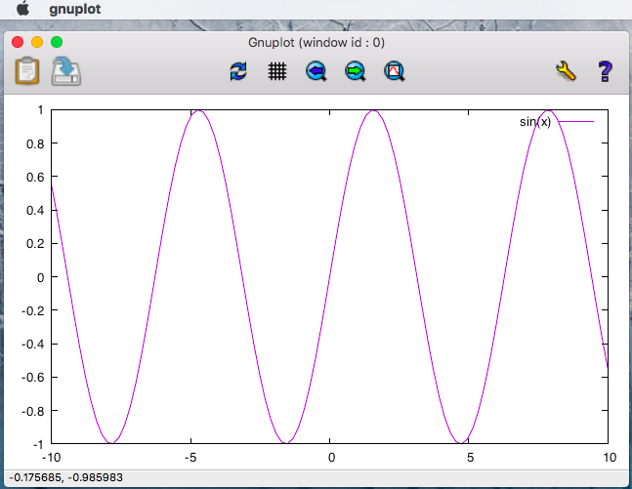
Test gnuplot
gnuplot> set term wxt
    Terminal type set to 'wxt'
    Options are '0 enhanced'
gnuplot> plot [-10:10] sin(x)
gnuplot>

Slide 61
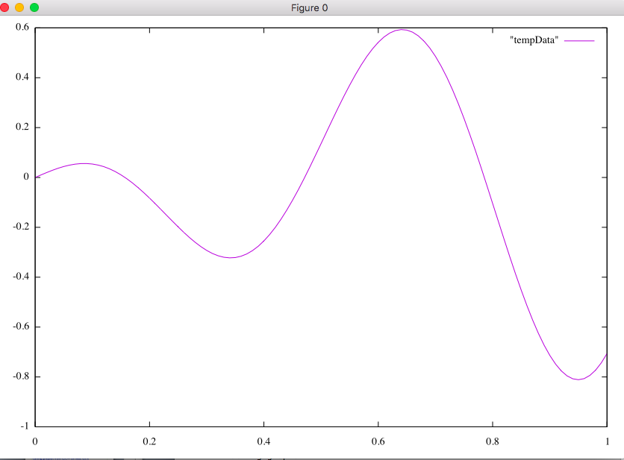
Using gnuplot inside your C++ program – gnuplot_ex

Slide 62
References
Financial Instrument Pricing Using C++, Daniel J. Duffy, ISBN 0470855096, Wiley, 2004.
Introduction to C++ for Financial Engineers: An Object-Oriented Approach, Daniel J. Duffy, ISBN 0470015381, Wiley, 2006
Quant Corner, quantcorner.wordpress.com/2012/04/08/using-libcurl-with-visual-c-2010/

